Slide 1
9/26/22

Slide 2
3.4
else-if review

Slide 3
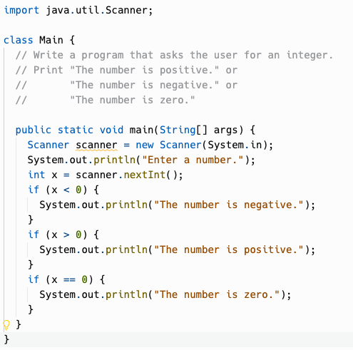
Code without else-if
if (x<0)
No
Yes
System.out.println
("Negative")
if (x>0)
Yes
System.out.println
("Positive")
No
if (x==0)
Yes
No
System.out.println
("Zero")

Slide 4
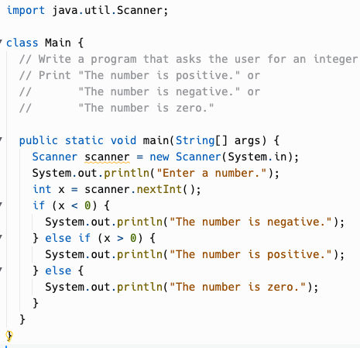
Code with else-if is faster
No
if (x<0)
Yes
if (x>0)
No
Yes
System.out.println
("Negative")
System.out.println
("Positive")
System.out.println
("Zero")
Jumps around remaining conditions
Can use information learned in previous cases – no longer need to check for zero explicitly, since number is known to not be positive or negative

Slide 5
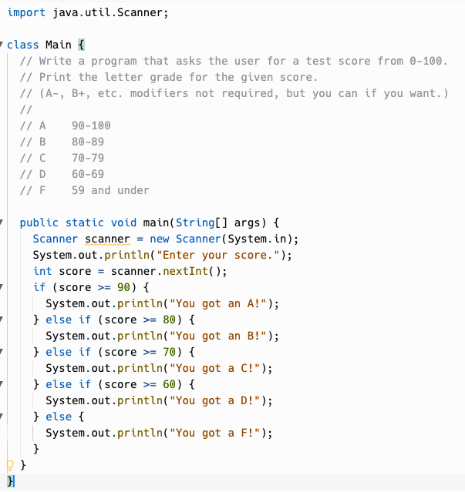
else if
In each else if, we still know what we learned from previous conditions.
if (score >= 80) ← if this is true, we don't need to also check that score<90.
We know it must be, or the if (score >= 90) case would've already executed and skipped the rest.
In the final else, we know that score<60 and don't have to check.

Slide 6
3.5
Compound Boolean Expressions

Slide 7
Logical Operators
Logical And
p && q
Evaluates boolean expressions p and q.
Evaluates to true if p and q are both true, false otherwise.
if (sunny && warm) { … }
Logical Or
p || q
Evaluates boolean expressions x and y.
Evaluates to true if p or q are true, false otherwise.
if (christmas || halloween) { … }
Logical Not
!p
Evaluates boolean expression p.
Evaluates to true if p is false.
Evaluates to false if p is true.
if (!day.equals("Sunday")) { … }
Why p and q? In logic textbooks, the "default" names for logical propositions are p and q.

Slide 8
Logical Or is inclusive or
Exclusive Or
In English, "or" is often exclusive or, choosing between two possibilities.
"Do you want to be Player 1 or Player 2 in this game?"
Inclusive Or
"He ate cake, or ice cream, or both."
Either proposition can be true for the whole statement to be true.
The || operator performs an inclusive or. Either side can be true for it to be true.
if (ateCake || ateIceCream) {
… executes if either is true …
}
Logical Or
p || q
Evaluates boolean expressions p and q.
Evaluates to true if p or q are true, false otherwise.
if (christmas || halloween) { … }

Slide 9
Why is it double &&, double ||?
This dates back to the C programming language (1970) that inspired Java and many other languages.
& and | are "bitwise" operators that "twiddle" individual bits in integers, like we saw with the binary addition repl.it exercise.
& and | were taken, so C used && and || for logical operators.
That made its way into many other languages, including Java, JavaScript, Ruby, Scala, Go, …
But not Python! Python spells out and and or !
C/C++/Java use symbols for most operators instead of words.
For this course, you don't need to know & and | . Just remember to use && and || instead!

Slide 10
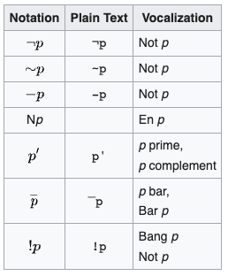
Why is it ! for logical negation?
Various notations to represent
logical negation (Wikipedia)
This dates back even before C, to the B programming language! (1969)
Python's equivalent operator is the word not
In logic, the symbol "¬" is often used to represent negation… but it is hard to type, and was even harder to type back in 1969! Keyboards usually have an exclamation point, though!
As Wikipedia says, people pronounce ! as "bang" or "not"

Slide 11
Truth Table - &&
p | q | p && q
true | true | true
true | false | false
false | true | false
false | false | false
Truth tables are a useful tool for mapping out the possible inputs and outputs of boolean expressions. This one is pretty simple, but truth tables can be very useful for understanding how complex boolean expressions behave.

Slide 12
Truth Table - ||
You Decide!
p | q | p || q
true | true
true | false
false | true
false | false

Slide 13
Truth Table - !
You Decide!
p | !p
true
false

Slide 14
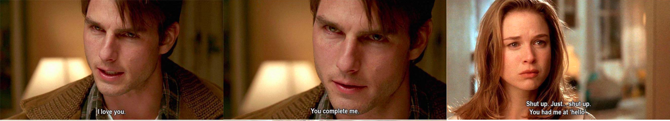
Short-Circuit Evaluation
When evaluating && and || expressions, Java will make its decision as early as possible.

Slide 15
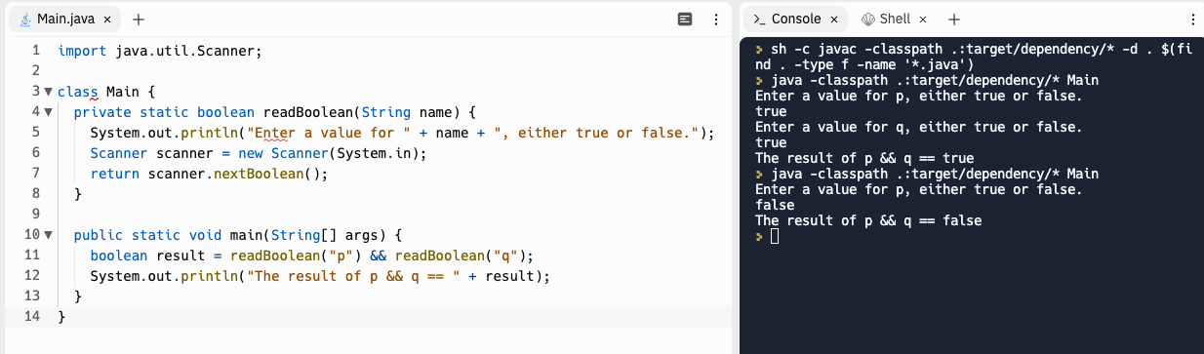
Short-Circuit Evaluation with &&
How Java evaluates p && q:
Evaluate p. If p is false, stop and return false.
Evaluate q. If q is true, return true, otherwise, return false.

Slide 16
Short-Circuit Evaluation with &&
Does p evaluate to true?
No
Yes
p && q
Does q evaluate to true?
No
Yes
true
false

Slide 17
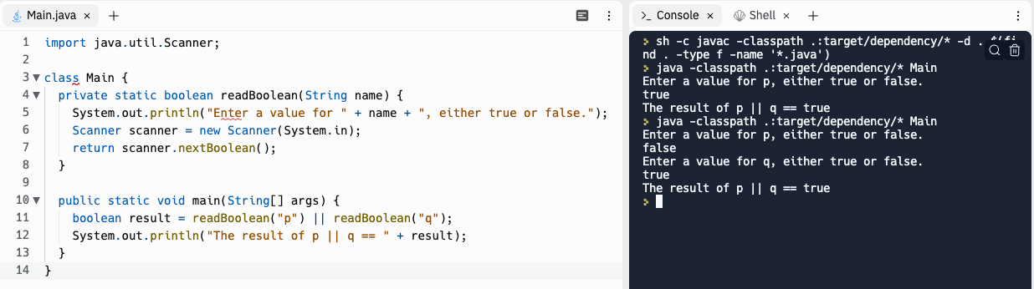
Short-Circuit Evaluation with ||
How Java evaluates p || q:
Evaluate p. If p is true, stop and return true.
Evaluate q. If q is true, return true, otherwise, return false.

Slide 18
Short-Circuit Evaluation with ||
Does p evaluate to true?
Yes
No
p || q
Does q evaluate to true?
Yes
No
false
true

Slide 19
Practice!
Repl.it for today:
Compound Boolean Expressions 1
Compound Boolean Expressions 2
cafeteria

